Slide 1

Lecture # 3
Digital Image Processing
Mathematical Operations
1st Semester
2019-2020
Dr. Abdulhussein Mohsin Abdullah
Computer Science Dept., CS & IT College, Basrah Univ.

Slide 2

Elementwise Versus Matrix Operations
An elementwise operation involving one or more images is carried out on a pixel-by-pixel basis.
For example, consider the following 2 X 2 images (matrices):
The elementwise product (often denoted using the symbol or ) of these two images is

Slide 3
The matrix product of the images is

Slide 4
Linear Versus Nonlinear Operations
Consider a general operator, ℋ, that produces an output image, g(x, y), from a given input image, f(x, y):
g(x, y) = ℋ[f(x, y)]
Given two arbitrary constants, a and b, and two arbitrary images f₁(x, y) and f₂(x, y) is said to be a linear operator if:
Additivity
ℋ [a f₁(x, y) + b f₂(x, y)] = ℋ [a f₁(x, y)] + ℋ [b f₂(x, y)]
= a ℋ [f₁(x, y)] + b ℋ [f₂(x, y)]
= a g₁(x, y) + b g₂(x, y)
Homogeneity
ℋ is said to be a nonlinear operator if it does not meet the above qualification.

Slide 5
Example
Suppose, ℋ , that is the sum operator ∑, The function performed by this operator is simply to sum its inputs.
∑ [a f₁(x, y) + b f₂(x, y)] = ∑ [af₁(x, y)] + ∑ [bf₂(x, y)]
= a ∑ [f₁(x, y)] + b ∑ [f₂(x, y)]
= a g₁(x, y) + b g₂(x, y)

Slide 6
Arithmetic Operations
Arithmetic operations between two images f(x, y) and g(x, y) are denoted as:
s(x, y) = f(x, y) + g(x, y)
d(x, y) = f(x, y) - g(x, y)
p(x, y) = f(x, y) X g(x, y)
v(x, y) = f(x, y) ÷ g(x, y)

Slide 7
Example: Addition of Noisy Images for Noise Reduction
Noiseless image: f(x, y)
Noise: n(x, y) (at every pair of coordinates (x, y), the noise is uncorrelated and has zero average value)
Corrupted image: g(x, y)
g(x, y) = f(x, y) + n(x, y)
Reducing the noise by adding a set of noisy images, {g_{i}(x, y)}

Slide 8
An Example of Image Subtraction: Mask Mode Radiography
Mask h(x,y): an X-ray image of a region of a patient’s body
Live images f(x,y): X-ray images captured at TV rates after injection of the contrast medium
Enhanced detail g(x,y)
g(x,y) = f(x,y) - h(x,y)
The procedure gives a movie showing how the contrast medium propagates through the various arteries in the area being observed.

Slide 9
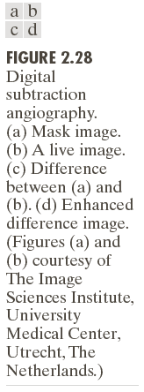

Slide 10
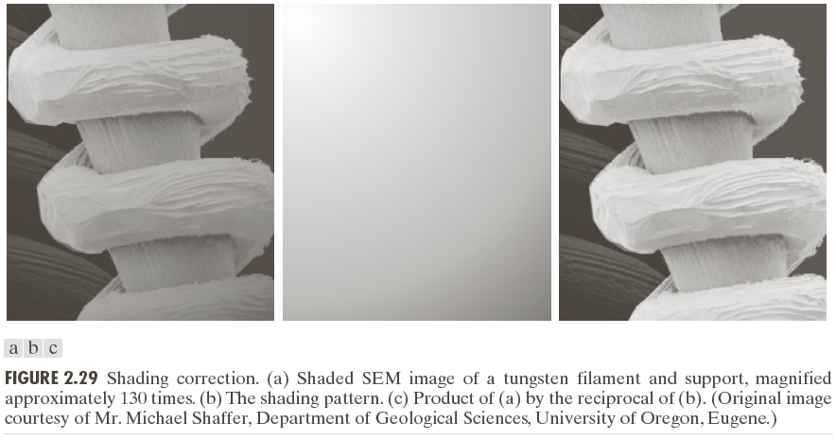
An Example of Image Multiplication

Slide 11
Set and Logical Operations

Slide 12
Set and Logical Operations
Let A be the elements of a gray-scale image
The elements of A are triplets of the form (x, y, z), where x and y are spatial coordinates and z denotes the intensity at the point (x, y).
The complement of A is denoted A^{c}

Slide 13
Set and Logical Operations
The union of two gray-scale images (sets) A and B is defined as the set

Slide 14
Set and Logical Operations

Slide 15

Set and Logical Operations

Slide 16
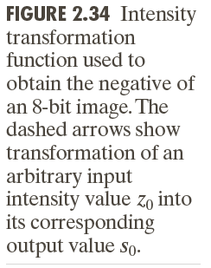
Spatial Operations
Single-pixel operations
Alter the values of an image’s pixels based on the intensity.
e.g.,

Slide 17
Spatial Operations
Neighborhood operations
The value of this pixel is determined by a specified operation involving the pixels in the input image with coordinates in S_{xy}

Slide 18
Spatial Operations
Neighborhood operations

Slide 19
Geometric Spatial Transformations
Geometric transformation (rubber-sheet transformation)
— A spatial transformation of coordinates
— intensity interpolation that assigns intensity values to the spatially transformed pixels.
Affine transform

Slide 21
Spatial Image Transformations
Affine transforms:
•
•
•
•
Translation
Scaling
Rotation
Shear

Slide 22




Example
homogeneous coordinates

Slide 23
homogeneous
coordinates

Slide 25
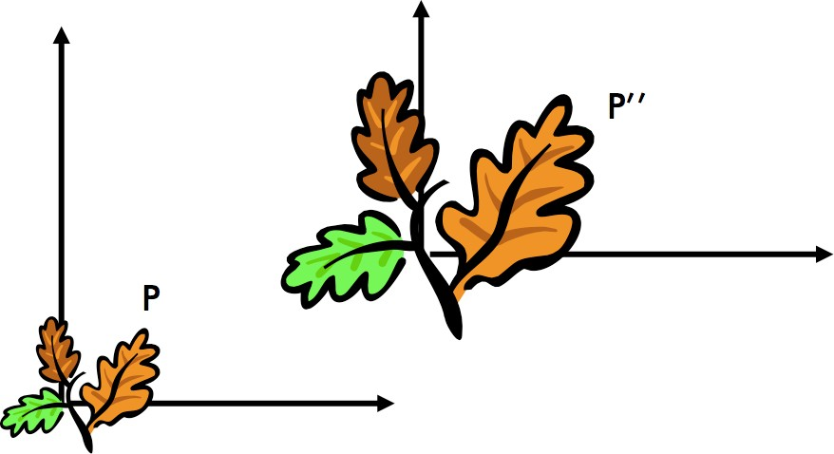
Complex Affine: First Scaling and then Translation
Is the ordering important?

Slide 27
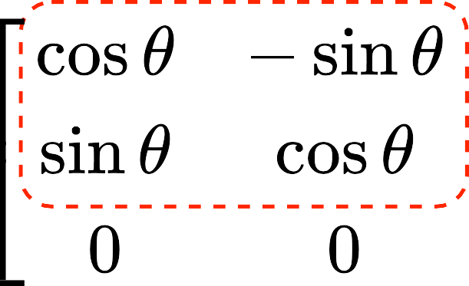
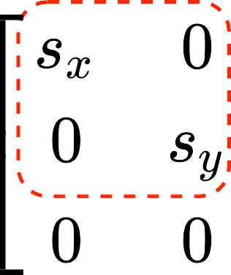

Complex: First Scaling, Then Rotation, Finally Translation
t
R
S
translation matrix
scaling matrix
rotation matrix

Slide 28
MATLAB Example
>>img=imread(image_name); %input image
>>tform = maketform(’affine’,T); % set transform
>>img_out = imtransform(img, tform, interp);
>>imshow(img_out)

Slide 29
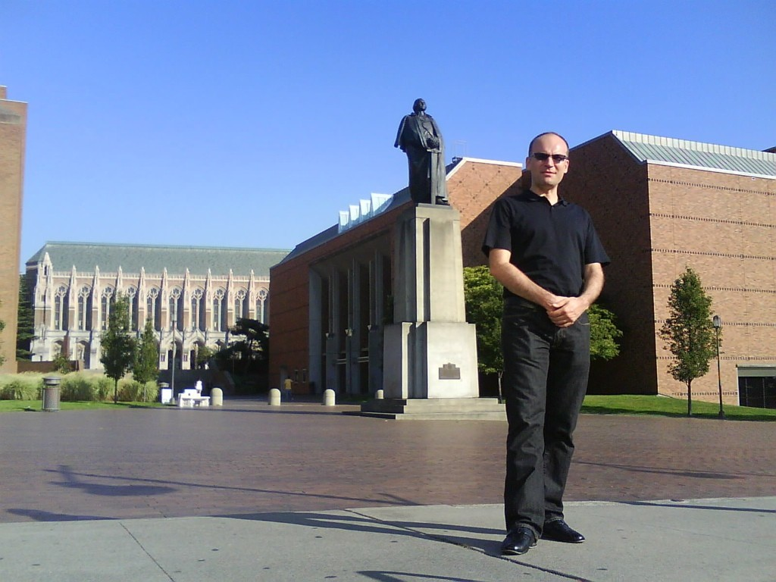
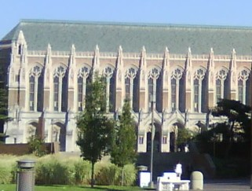
Image Interpolation
original
resampling
shrinking
zooming

Slide 30
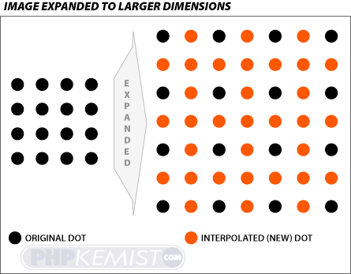
Image Interpolation

Slide 31

Bilinear Interpolation
f (x, y) = ax + by + cxy + d
coefficients that need to be estimated

Slide 32
Bilinear Interpolation
f (x, y) = ax + by + cxy + d
coefficients that need to be estimated
?

Slide 33
Bilinear Interpolation
f (x, y) = ax + by + cxy + d
coefficients that need to be estimated
?
nearest neighbor

Slide 34
Bilinear Interpolation
f (x, y) = ax + by + cxy + d
coefficients that need to be estimated
?

Slide 35
Bilinear Interpolation
f (x, y) = ax + by + cxy + d
coefficients that need to be estimated
?
nearest neighbor

Slide 36
Bilinear Interpolation
f (x, y) = ax + by + cxy + d
1
2
coefficients that need to be estimated
?
4
3
nearest neighbor

Slide 37
Bilinear Interpolation
f (x, y) = ax + by + cxy + d
1
2
coefficients that need to be estimated
ax₁ + by₁ + cx₁y₁ + d = f (x₁, y₁)
ax₂ + by₂ + cx₂y₂ + d = f (x₂, y₂) ax₃ + by₃ + cx₃y₃ + d = f (x₃, y₃) ax₄ + by₄ + cx₄y₄ + d = f (x₄, y₄)
?
4
3
nearest neighbor
a, b, c, d

Slide 38
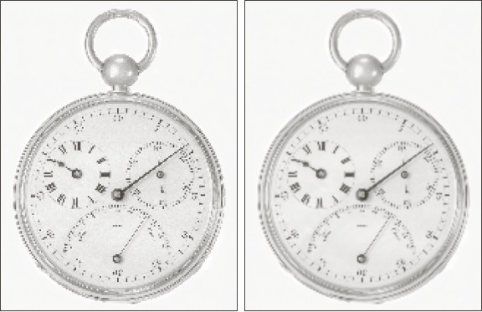
Example: Zooming-in
nearest neighbor
bilinear

Slide 39
Image Interpolation
Bilinear N = 1
Bicubic N = 3

Slide 40
Intensity Transformations of Images
g(x, y) = T{f (x, y)}
transformed input
input

Slide 41
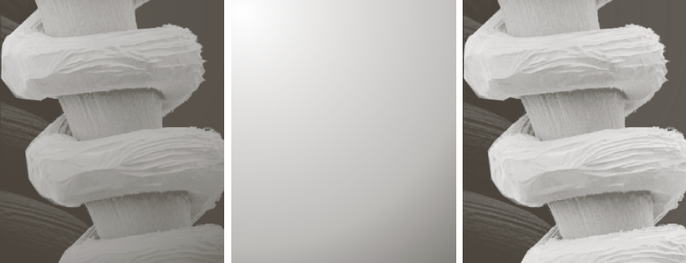
Example: Shading Correction
g(x, y) = f (x, y)h(x, y)
input
shading profile
f(x,y)/shading

Slide 42
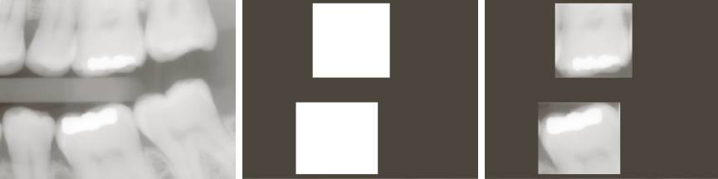
Example: Masking
g(x, y) = f (x, y)h(x, y)
input
mask
f(x,y) * mask

Slide 43


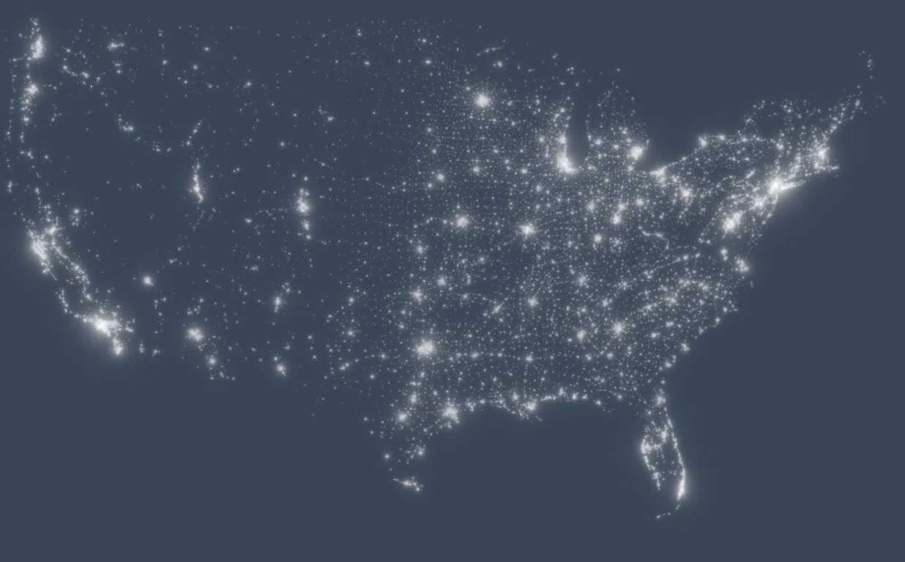
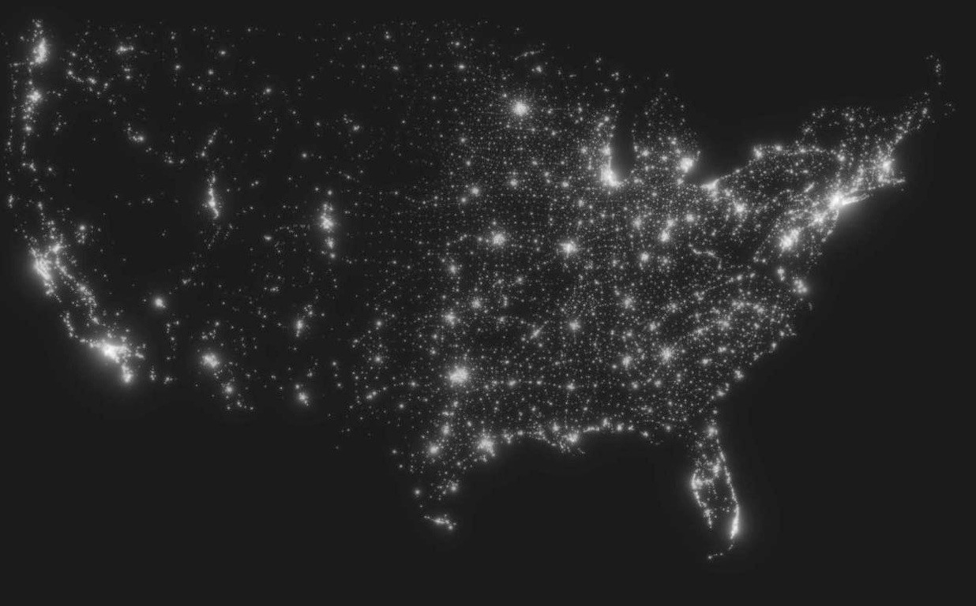
Rescaling Intensity Values
input
output

Slide 44

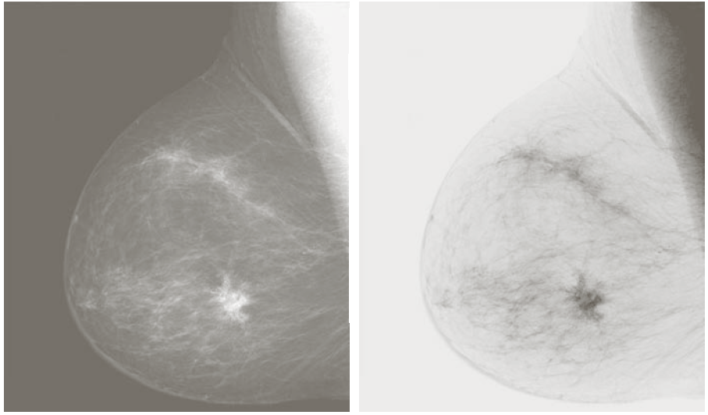
Image Negatives
g(x, y) = L — 1 — f (x, y)

Slide 45
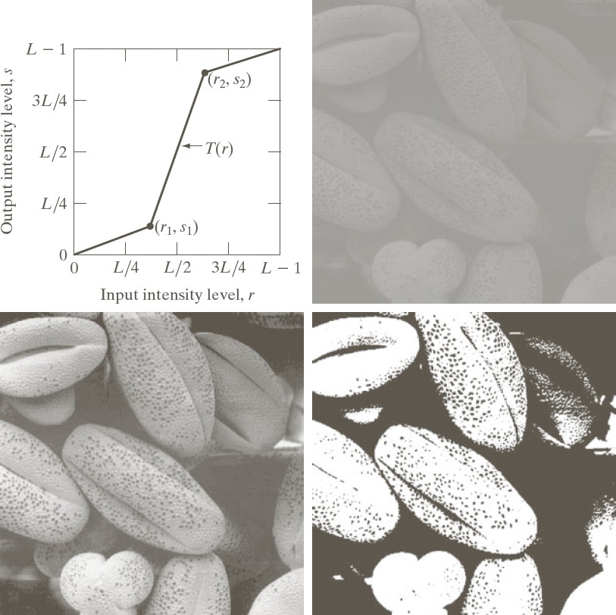
Contrast Stretching
input
output
thresholded

Slide 46
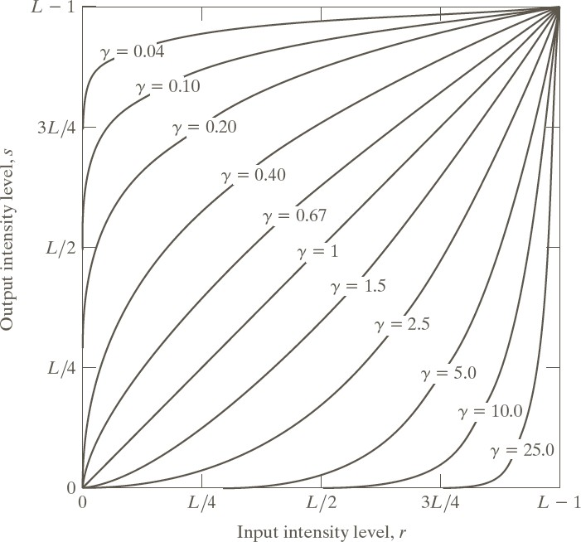
Gamma Correction
s = cr^{ç}

Slide 47


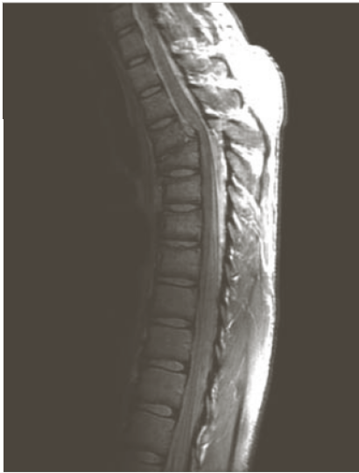
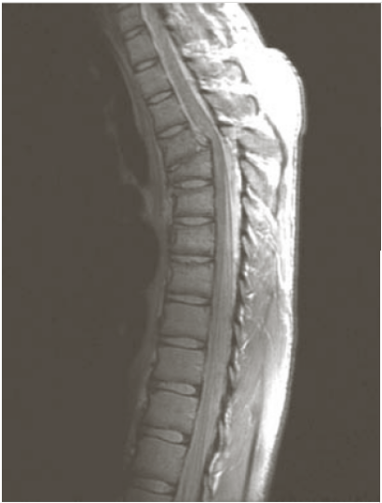
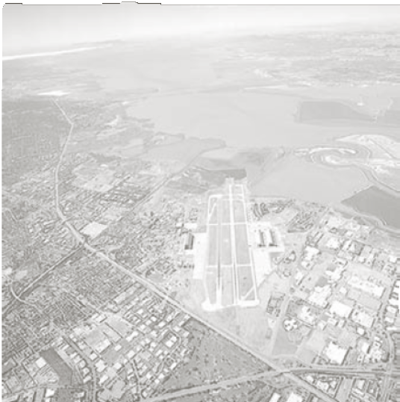
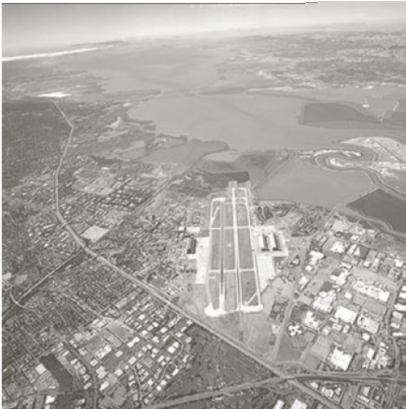
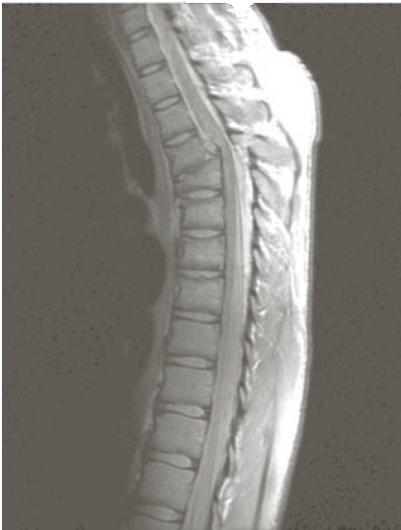
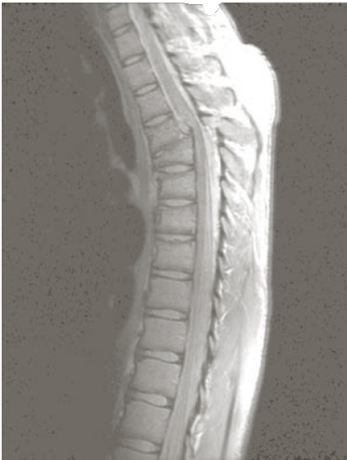
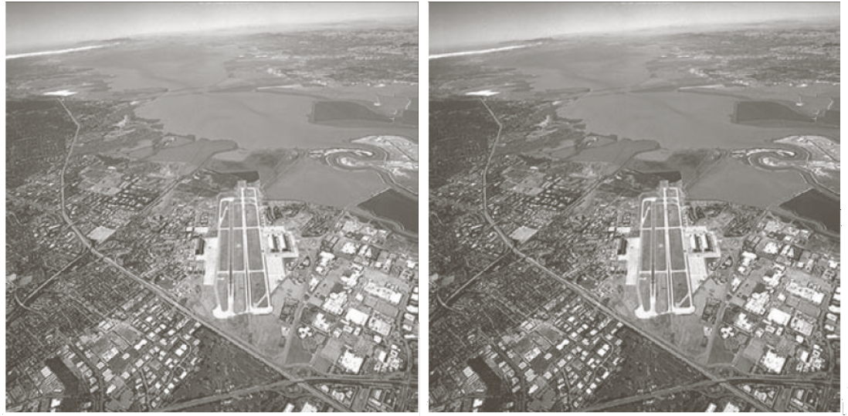
Example: Gamma Correction
input
γ=.6
input
γ=3
γ=.4
γ=.3
γ=4
γ=5

Slide 48
Intensity Assignment
Forward Mapping
It’s possible that two or more pixels can be transformed to the same location in the output image.
Inverse Mapping
The nearest input pixels to determine the intensity of the output pixel value.
Inverse mappings are more efficient to implement than forward mappings.

Slide 49
Example: Image Rotation and Intensity Interpolation

Slide 50
Image Registration
Input and output images are available but the transformation function is unknown.
Goal: estimate the transformation function and use it to register the two images.
One of the principal approaches for image registration is to use tie points (also called control points)
The corresponding points are known precisely in the input and output (reference) images.

Slide 51
Image Registration
A simple model based on bilinear approximation:

Slide 52
Image Registration

Slide 53
Image Transform
Image transforms can be simple arithmetic operations on images or complex mathematical operations which convert image from one representation to another.
Or
A function or operator that takes an image as its input and produces an image as its output. Depending on the transform , the input and output images may appear entirely differently and have different interpretations

Slide 54
Need of Image Transforms:
Viewing an image in different domains enables the identification of features that may not be as easily detected in spatial domain.
Image transforms are used majorly in feature extraction, image compression and image enhancement.

Slide 55
Image Transform
A particularly important class of 2-D linear transforms, denoted T(u, v)

Slide 56
Image Transform
Given T(u, v), the original image f(x, y) can be recoverd using the inverse tranformation of T(u, v).

Slide 57
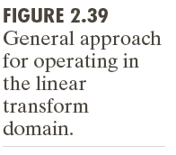
Image Transform

Slide 58
Example: Image Denoising by Using DCT Transform

Slide 59
Forward Transform Kernel

Slide 60
The Kernels for 2-D Fourier Transform

Slide 61
2-D Fourier Transform

Slide 62
Probabilistic Methods

Slide 63
Probabilistic Methods

Slide 64
Example: Comparison of Standard Deviation Values

